Slide 1
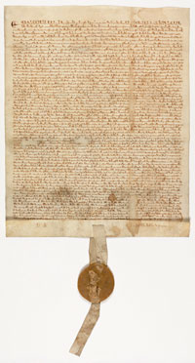
Inspiration for a New Nation
SS.7.C.1.2 Trace the impact that the Magna Carta, English Bill of Rights, Mayflower Compact, and Thomas Paine’s Common Sense had on colonists’ views of government.
Historical Documents and Their Impact on the Founders

Slide 2
Bell Ringer
Imagine you are on a cruise with a group of 20+ friends when all of a sudden the boat is lost in a storm. You finally spot land in the distance and the group makes its way towards it. As you get closer, you quickly realize there is no civilization on the island. Hungry and exhausted, everyone begins to argue. You all decide that rules have to be made for everyone’s protection and benefit.
Brainstorm about what you and your friends would do.
What rules do you think you and your friends would make? Come up with at least 3.
Would you make these rules before or after you arrive onto the island? Why?
Would there be a single leader or group of leaders? How would you choose them? Explain.
Notes:
Ask students where they think the colonists and Founders got their ideas about our government. Discuss responses.

Slide 3


Inspiration for a New Nation
Where did the colonists and the Founding Fathers get their ideas about our government?
Notes:
Ask students where they think the colonists and Founders got their ideas about our government. Discuss responses.

Slide 4

Influential Individuals
Locke
M
Montesquieu
Natural Law
Locke’s social contract
Separation of Power
ocke
The Government
The people
Social
Contract
Executive
Judicial
Legislative

Slide 5
Important Ideas
Rule of Law
All people must follow the laws, and the laws should be enforced fairly and equally.
Self-Government
People can make decisions on how their government should work.
Notes:
Ask students where they think the colonists and Founders got their ideas about our government. Discuss responses.

Slide 6
Important Ideas
Limited Government
A government that has been limited in power by a constitution, or written agreement.
Rights
Guarantees or protections for our freedoms
Social Contract
An agreement among the people to set up a government and obey its laws.
John Locke
Notes:
Ask students where they think the colonists and Founders got their ideas about our government. Discuss responses.

Slide 7
Magna Carta
Written in 1215 in England
Also known as the “Great Charter”
Written by the English nobles (the wealthy princes and dukes of England who were, in theory, loyal to the king) → govt document
Granted certain rights and liberties to English nobles:
Right to a jury and speedy trial
Guarantees against the loss of life, liberty, or property
Was agreed to by King John of England – no one was above the law
"To no one will We sell, to no one will We deny or delay, right or justice.“
National Archives and Records Administration. "Featured Document: The Magna Carta." National Archives and Records Administration. Web. 28 Mar. 2012. <http://www.archives.gov/exhibits/featured_documents/magna_carta/>.
Notes:
Discuss facts about Magna Carta and instruct students to write information about the document in the appropriate section of their foldable note taker.

Slide 8
Magna Carta
This was the first example
of limited government.
Specifically, a limited monarchy
Why is the concept of “limited government” important?
What would a government without limits be like?
Notes:
The main ideas in the Magna Carta are limited government and the Rule of Law.
Discuss why limited government is so important. Try to have students make a connection to Montesquieu and the separation of power and the need to check power.
Rule of Law will be further discussed on the following slide.

Slide 9
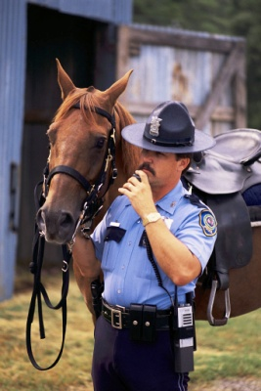


The Magna Carta also addressed the “Rule of Law”
What do you think “Rule of Law” means?
No one – not the King, the President, celebrities, you, the teacher, the principal – is above the law.
Everyone is equal under the law
RULE OF LAW
Notes:
Ask students what they think “rule of law” means. Discuss responses.
The Rule of Law is that no one is above the law and the law applies to everyone. Ask students if they think this is important to outline in a government. If so, why? If not, why not?

Slide 10
Magna Carta
Inspiration for the Nation
Limited Government
Rule of Law + Rights
Notes:
This slide will appear multiple times to outline all of the main ideas from the documents the Founders used in moving towards declaring independence and utilizing in the creation of the new government.

Slide 11
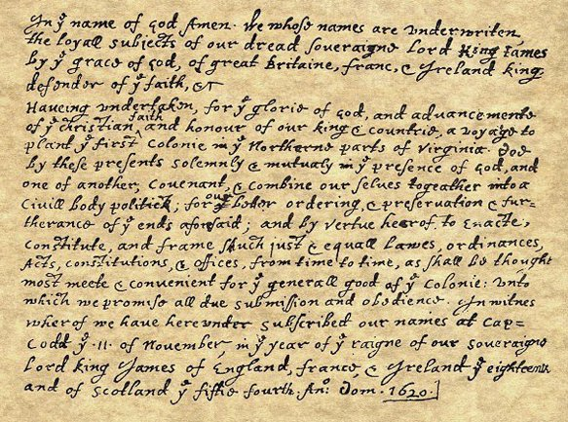
Mayflower Compact
Written aboard the Mayflower in 1620 before the ship landed in Plymouth, Massachusetts in 1620.
Signed by most passengers on the voyage (the Pilgrims) → agreement of individuals
Image from http://www.historyplace.com/unitedstates/revolution/revgfx/may-compact.jpg
“…Having undertaken…a Voyage to plant the First Colony in the Northern parts of Virginia, do by these present solemnly and mutually in the presence of…one another, Covenant and Combine ourselves together into a Civil Body Politic, for our better ordering and preservation…to enact constitute, and frame such just and equal Laws, Ordinances, Acts, Constitutions, and offices from time to time , as shall be thought most meet and convenient for the general good of the colony…”
Notes:
Students should write facts about the Mayflower compact in the appropriate section of the foldable note taker.
Either read the quote aloud to the students or have multiple students read different sections. Discuss the quote with the students, focusing on the highlighted portions.
The highlighted portions discuss the ideas of self government, social contract, and the need for government to maintain order.

Slide 12
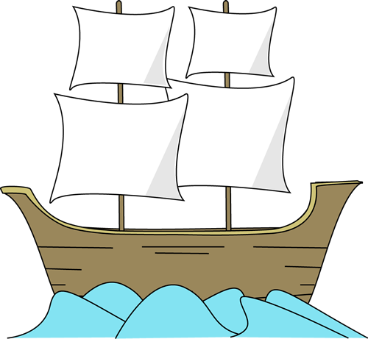
Mayflower Compact
This document served as an example of self -government and John Locke’s social contract.
Why would the colonists want to create a document establishing self government?
GOVERNMENT
SELF
Why would government be necessary according to the Mayflower Compact?
“…For our better ordering and preservation…”
Notes:
Discuss the main ideas of self government and consent of the governed (make connection to John Locke). Review what it would be like to live in a state without any government and discuss the need for government to maintain order and to protect the rights of those living under the government.

Slide 13
Magna Carta
Inspiration for the Nation
Mayflower Compact
Limited Government
Rule of Law + Rights
Self-government
Social contract

Slide 14
English Bill of Rights
Written in 1689 in England
Authored by members of Parliament (the legislative branch, or the branch that makes laws)
This government document established a limited monarchy (king) and gave more power to Parliament.
That excessive bail ought not to be required, nor excessive fines imposed; nor cruel and unusual punishments inflicted.
“That the freedom of speech, and debates or proceedings in parliament, ought not to be impeached or questioned in any court or place out of parliament.”
Notes:
Discuss the facts about the English Bill of Rights.
Have student read the quotes aloud. Discuss the meaning on each quote.
Blue quote: no excessive bail or fines, no cruel and unusual punishment (later found in the Constitution)
Green Quote: Freedom of speech and debate in parliament is not to be limited or questioned out of parliament

Slide 15
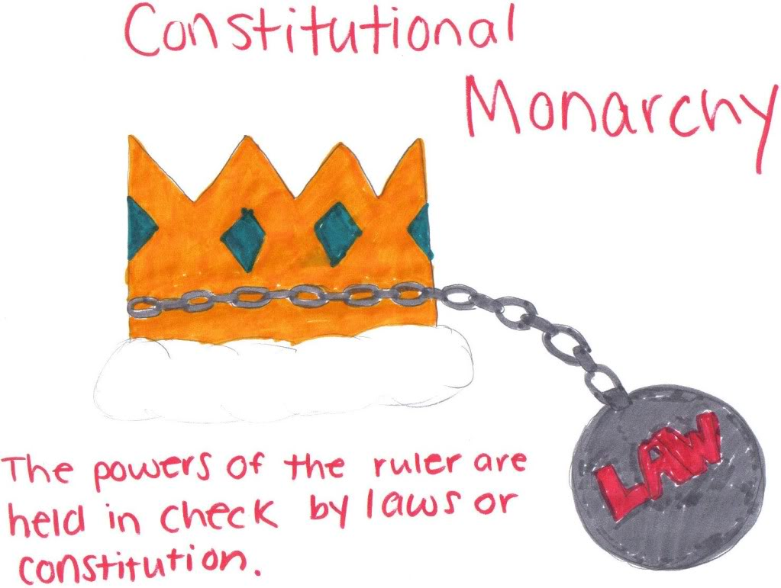
English Bill of Rights
The monarchy was not allowed to:
Collect taxes without consent of Parliament
Interfere with the right to free speech and debate in Parliament
Maintain an army in peace time
Require excessive bail or cruel punishments for those accused or convicted of crimes
Declare laws made by Parliament should not be obeyed
Here we have another example of limited government.
Specifically, a limited monarchy
Notes:
The English Bill of Rights created a limited monarchy and thus, a limited government. It also reinforced the idea of Rule of Law.

Slide 16
Also in the English Bill of Rights …
RULE OF LAW
The English Bill of Rights included limits on the power of the king.

Slide 17
Magna Carta
Inspiration for the Nation
Mayflower Compact
Limited Government
Rule of Law + Rights
Self-government
Social contract
Limited Government
Rule of Law + Rights
English Bill of Rights

Slide 18
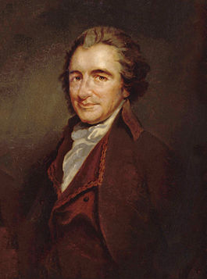
“Common Sense”
A pamphlet written by Thomas Paine
Published in 1776 in the American colonies
Challenged the authority of the British government and the royal monarchy.
First work to openly ask for independence from Great Britain.
Discussed the purpose of government and the need for independence from Great Britain.
Because these things were COMMON SENSE!
Oil painting by Auguste Millière (1880) from http://en.wikipedia.org/wiki/Thomas_Paine
Notes:
Students should write information about Common Sense in the appropriate section on their foldable note taker.

Slide 19
Common Sense
Society in every state is a blessing, but Government, even in its best state, is but a necessary evil…Wherefore, security being the true design and end of government, it unanswerably follows that whatever form thereof appears most likely to ensure it to us, with the least expense and greatest benefit, is preferable to all others.
Notes:
Have students read the quote aloud. Discuss the key points highlighted.
The main function of government is to provide security for the people with the least expense to the people (not sacrificing their rights) and the greatest benefit to all.

Slide 20
Magna
Carta
Inspiration for the Nation
Mayflower Compact
Limited Government
Rule of Law
Self-government
Social contract
Limited Government
Rule of Law
Self-government
Social contract
English Bill of Rights
Common Sense

Slide 21
Document Timeline
English Bill of Rights
1689
Established a limited monarchy and gave power to the law making body . It also reinforced the idea of Rule of Law.
Magna Carta
1215
Created the first example of a limited monarchy and the rule of law.
Mayflower Compact
1620
Provided for the idea of self government and social contract among the colonists.
Common Sense
1776
Discussed the purpose of government and the need for American independence from the British crown.
Notes:
This slide gives a brief overview and timeline of the documents that contributed to the Founders’ ideas about good government. Students should note the dates on their foldable. The Foldable is now a timeline study guide to remember the concepts from these key documents.

Slide 22
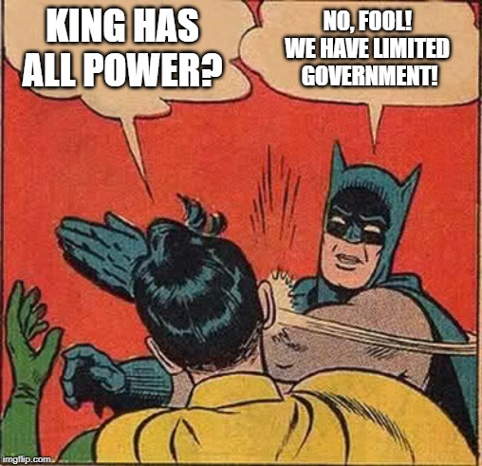
Meme

Slide 23
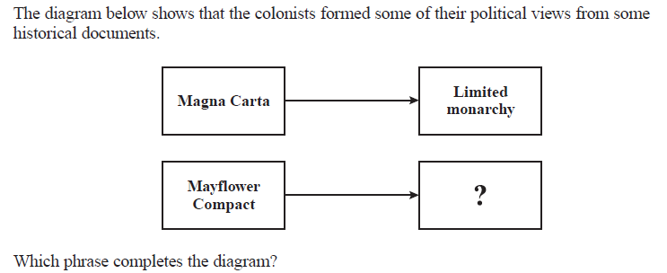
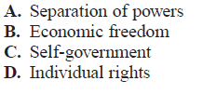
Checking for Understanding

